Slide 1

Using Reward Machines for High-Level Task Specification and Decomposition in Reinforcement Learning
Rodrigo Toro Icarte, Toryn Q. Klassen, Richard Valenzano, Sheila A. McIlraith
Mohan Li
2025-04-18

Slide 2
background:
the agent does not have access to the environment model
a programmed reward function is given as a black box to the agent
idea:
use the specification of the reward function to decompose the problem and speed up learning
contributions:
Reward Machine-decompose different reward functions in flexible ways
QRM- learns one subpolicy per state in the RM and uses off-policy learning to train each subpolicy in parallel

Slide 3
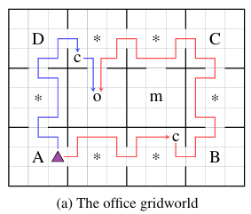
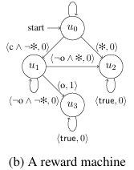
S: a set of environment states
P: a set of relevant high-level events
σt: a truth assignment
U: a finite set of states
δu: the state-transition function
δr: the reward-transition function

Slide 4
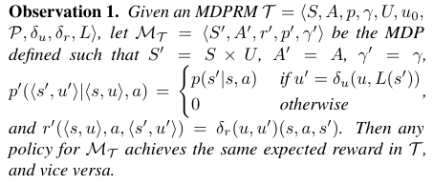
MDPRM
idea: replace the standard reward function in an MDP by a reward machine
a labelling function which assigns truth calues to the symbols in P given an environment state
MDP
RM
RM can express:
-any Markovian reward functions
-some non-Markovian reward functions

Slide 5
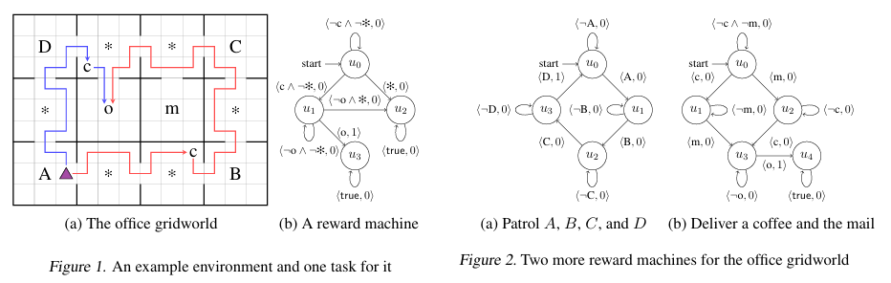
task 1: bring coffee to the office without breaking any decoration
task 2: patrol locations A,B,C,D in order
task 3: deliver a coffee and the mail to the office

Slide 6
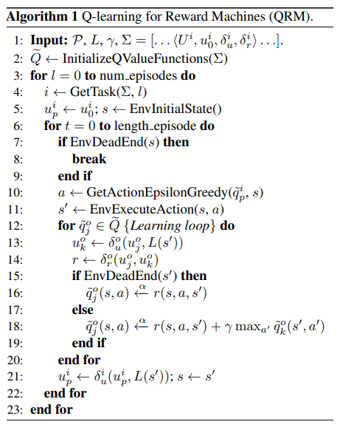
Q-learning for Reward Machines(QRM)
goal: learn an optimal policy for each of the tasks
∑: a list of reward machines over P
Q stores q-functions
1st loop: iterate over the total number of training episodes
2nd loop: run an episode on the current task for a maximum number of steps
3rd loop: learning loop
advantages:
-does not prune optimal policies when decomposing the task
-learns every sub-task in parallel using off-policy RL
replace q-learning by Double DQN -> Deep Q-Learning for Reward Machines(DQRM) continuous state spaces

Slide 7
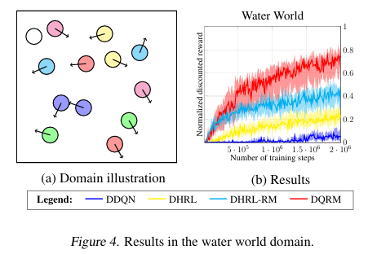
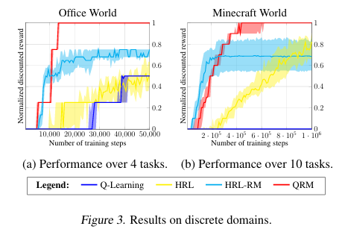
Experimental Evaluation
baselines
q-learning(discrete)/Double DQN(continuous)
option framework(discrete)/DHRL(continuous)
HRL-RM(discrete)/DHRL-RM(continuous)
QRM has the best of the two worlds:learns the optimal policies and leans at a comparable rate th HRL methods
encouraging result

Slide 8
Thanks
criticize and correct

